Slide 1
Week 19 hFGC Analysis
Have realigned the transcriptome and repeatome.
Our “Laird Lab” transcriptome alignment has been run through Seurat and replicates “LiLi prev pub” transcriptome.
Repeatome added as a layer to analyze transposon expression in cells

Slide 2
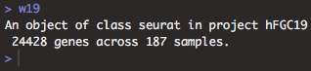
The following slides are analysis of the Laird transcriptome alignment.
Our alignment pipeline is a success! :D
Clusters determined based only on transcriptome data.
Repeatome expression is as a “layer” (rather than including the repeatome genes in the cluster determining gene set)
qc results in 24428 transcriptome genes across 187 samples

Slide 3
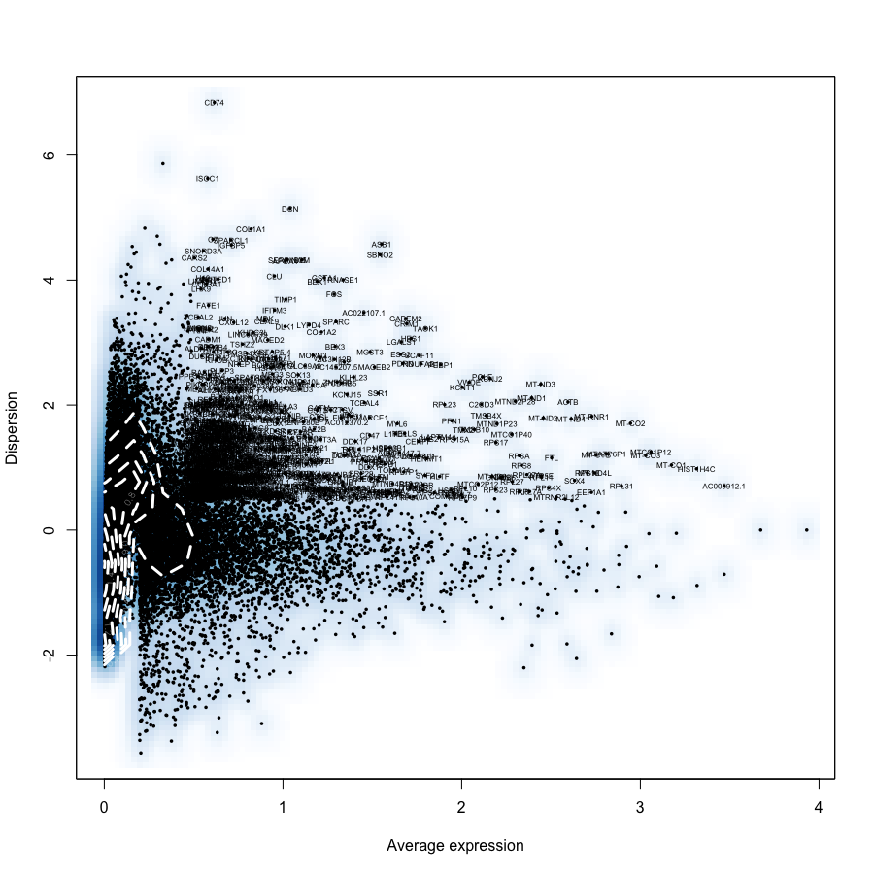
Differentially expressed genes across all w19 cells

Slide 4
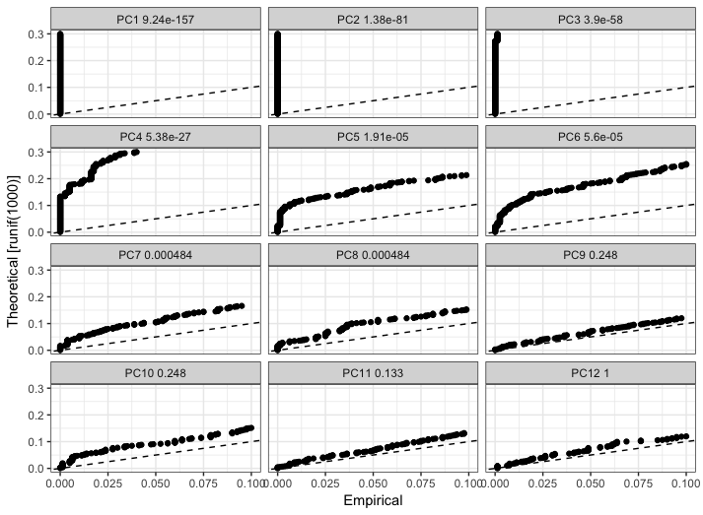
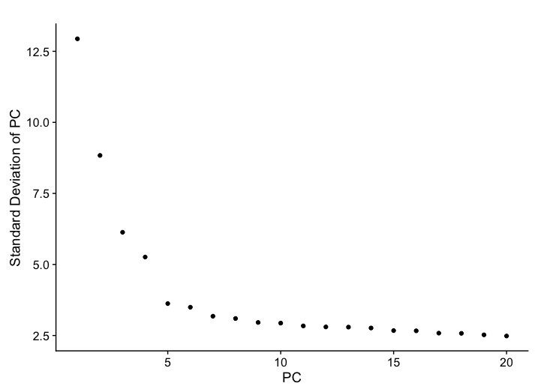
Jackstraw Analysis showing PC 1 through 8 are Significant
Elbow Plot showing decent “elbow” angle at PC 8-10

Slide 5
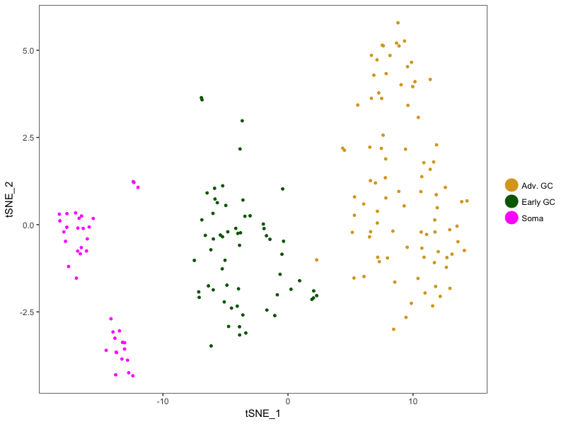
tSNE plot with Cluster ID 0 through 2 (generated from PC 1:8)
# cells:
Cluster Adv = 88
Cluster Early = 60
Cluster Soma = 39

Slide 6
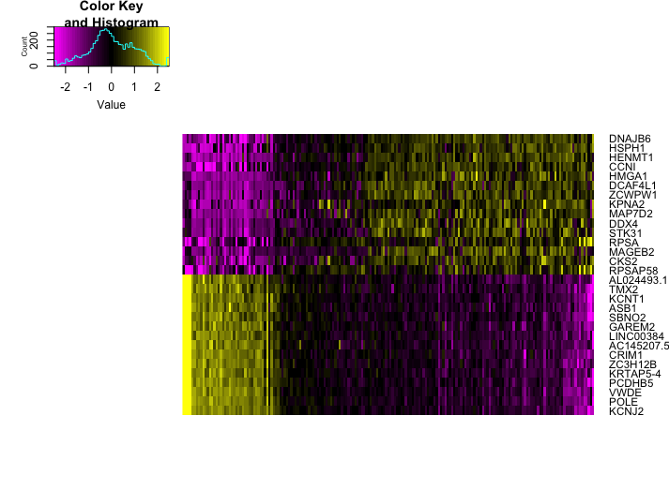
Top 10 genes for PC1

Slide 7
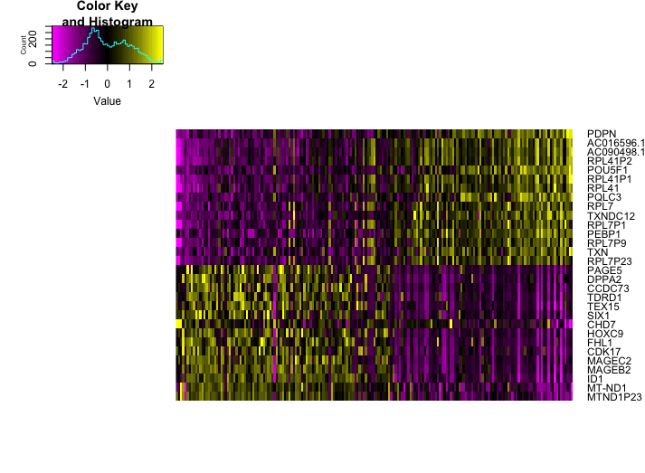
Top 10 genes for PC2

Slide 8
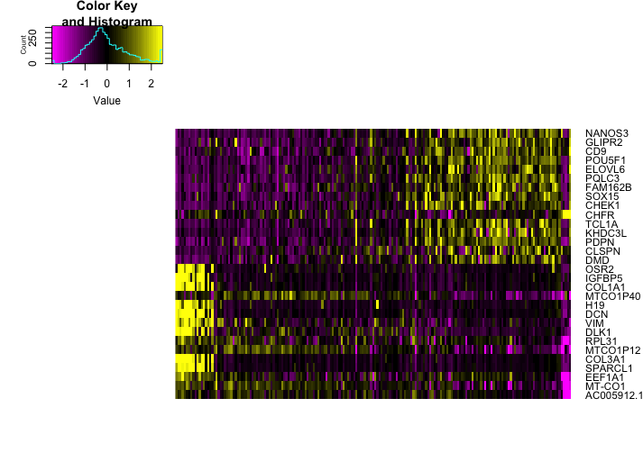
Top 10 genes for PC3

Slide 9
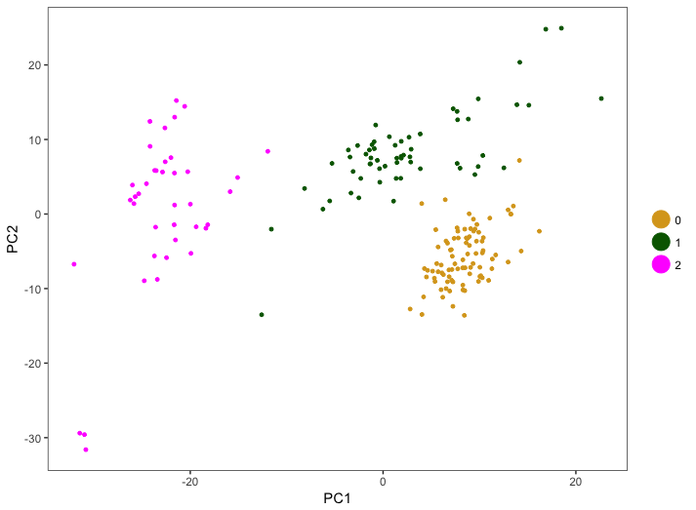
PC1 vs PC2 with Cluster ID 0 through 2
# cells:
Cluster Adv = 88
Cluster Early = 60
Cluster Soma = 39

Slide 10
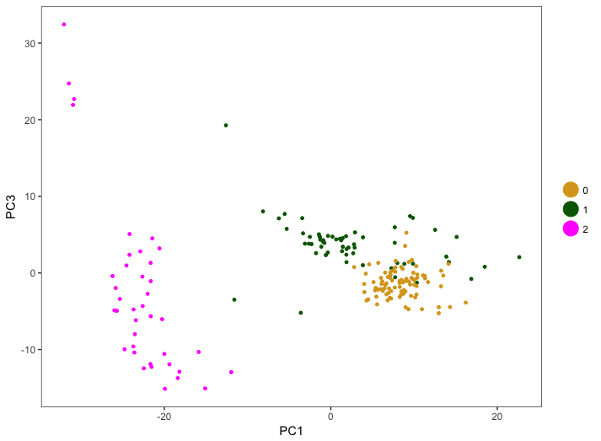
PC1 vs PC3 with Cluster ID 0 through 2
# cells:
Cluster Adv = 88
Cluster Early = 60
Cluster Soma = 39

Slide 11
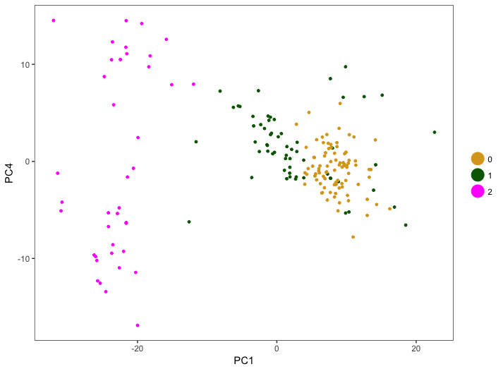
PC1 vs PC4 with Cluster ID 0 through 2
# cells:
Cluster Adv = 88
Cluster Early = 60
Cluster Soma = 39

Slide 12
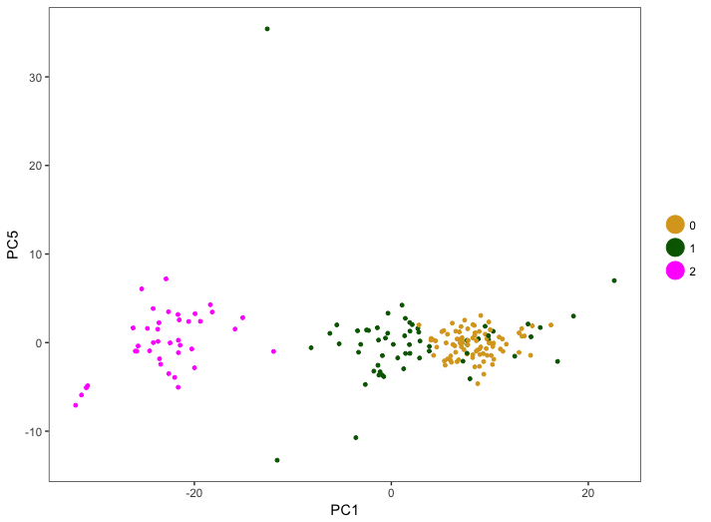
PC1 vs PC5 with Cluster ID 0 through 2
# cells:
Cluster Adv = 88
Cluster Early = 60
Cluster Soma = 39

Slide 13
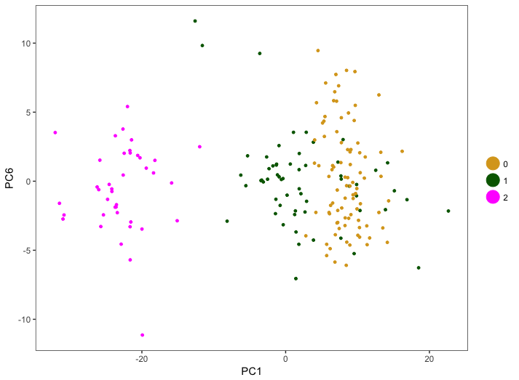
PC1 vs PC6 with Cluster ID 0 through 2
# cells:
Cluster Adv = 88
Cluster Early = 60
Cluster Soma = 39

Slide 14
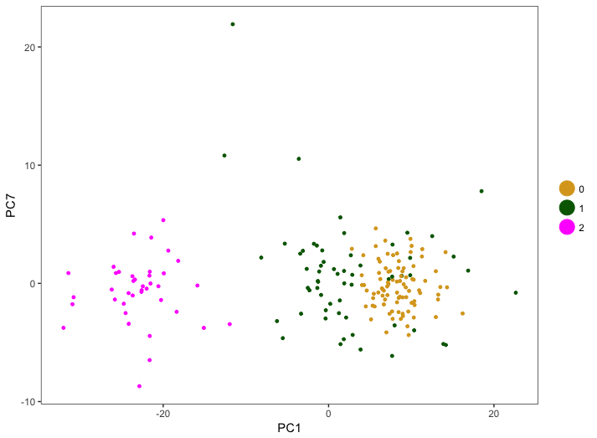
PC1 vs PC7 with Cluster ID 0 through 2
# cells:
Cluster Adv = 88
Cluster Early = 60
Cluster Soma = 39

Slide 15
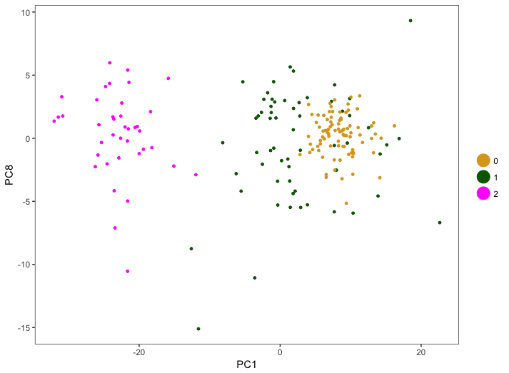
PC1 vs PC8 with Cluster ID 0 through 2
# cells:
Cluster Adv = 88
Cluster Early = 60
Cluster Soma = 39

Slide 16
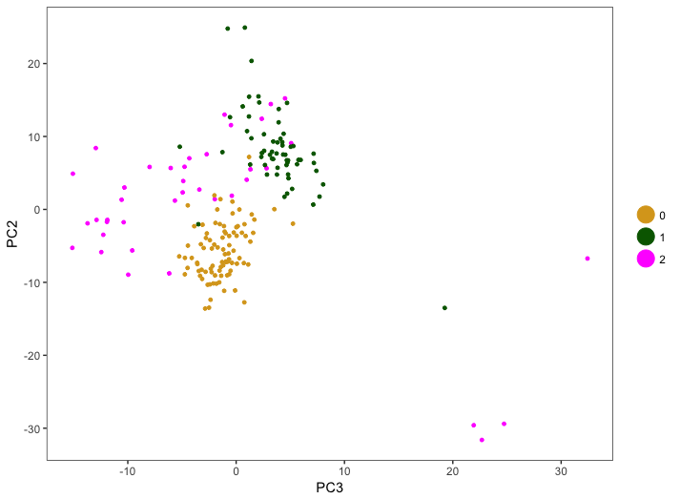
PC2 vs PC3 with Cluster ID 0 through 2
# cells:
Cluster Adv = 88
Cluster Early = 60
Cluster Soma = 39

Slide 17
tSNE for Cluster ID 0 through 2
# cells:
Cluster Adv = 88
Cluster Early = 60
Cluster Soma = 39

Slide 18
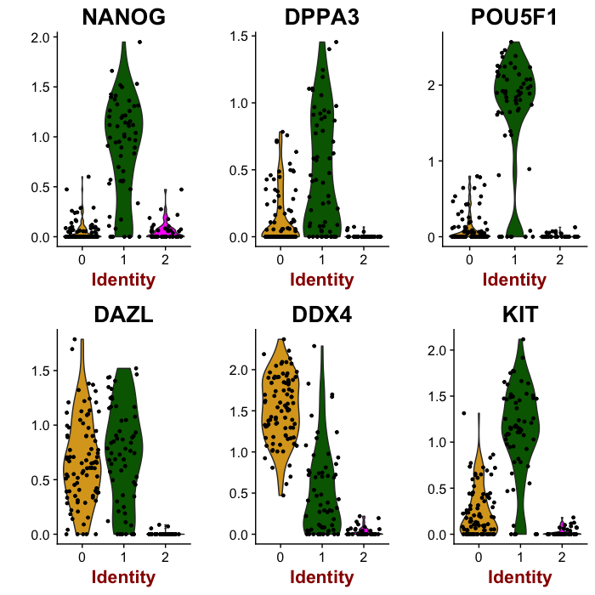
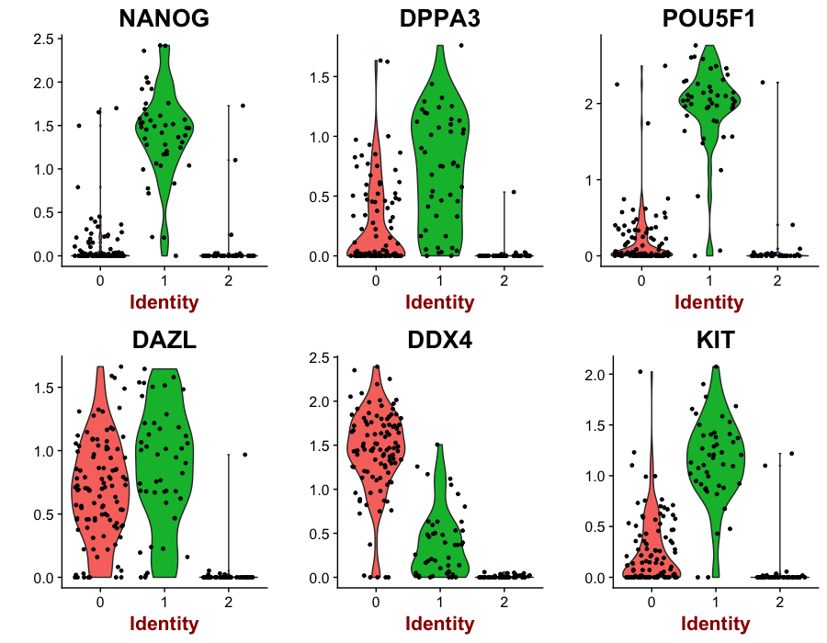
Expression of several GC makers
Laird Alignment
LiLi Alignment

Slide 19
Maintained Conclusions
Conclusions: Clusters 0 and 1 are Germ Cells : Cluster 1 is “less advanced” hFGC population : Cluster 0 is “more advanced” hFGC population : Cluster 2 is a somatic cell population

Slide 20
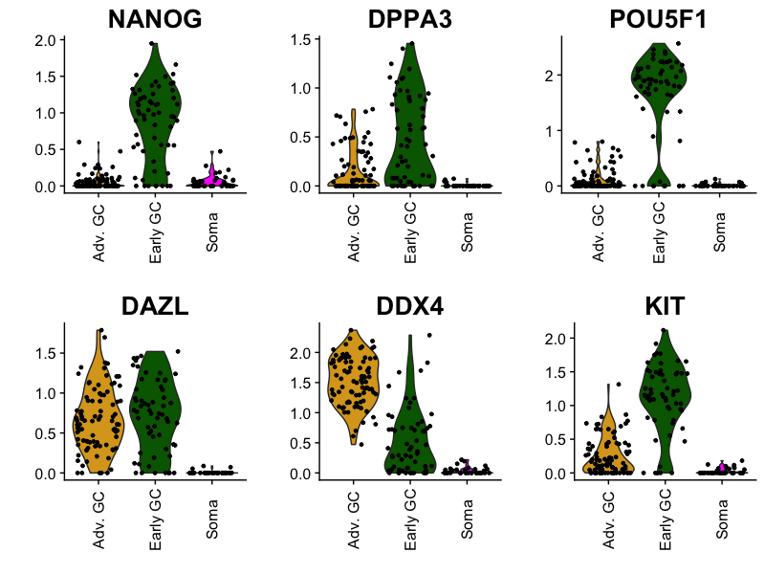
Expression of several GC makers

Slide 21
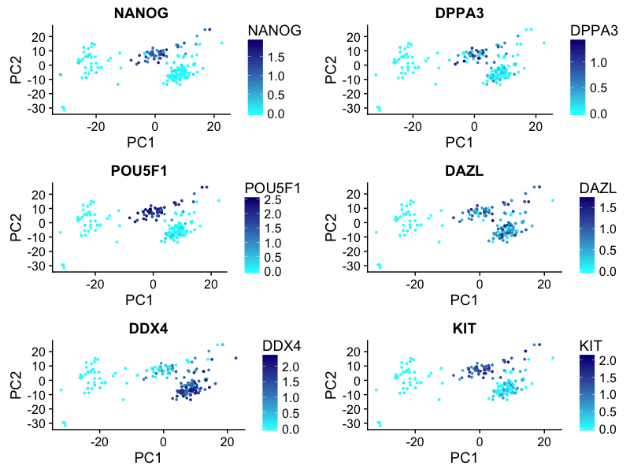
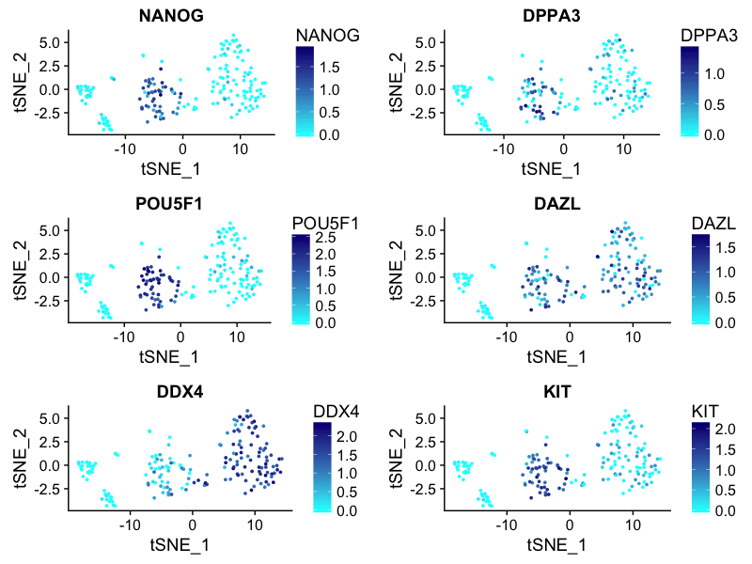
Expression of several GC makers
PCA space
tSNE space
VASA^{neg} OCT4^{neg} germ cells?

Slide 22
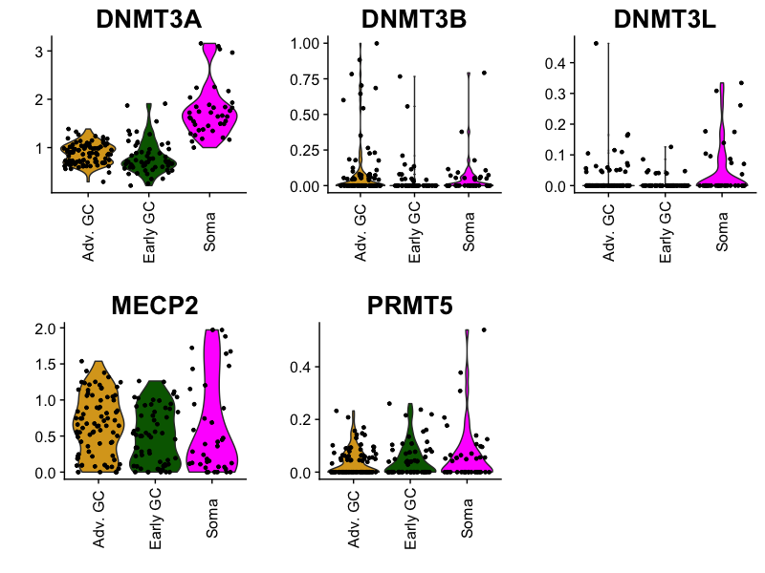
DNA Methylation Genes

Slide 23
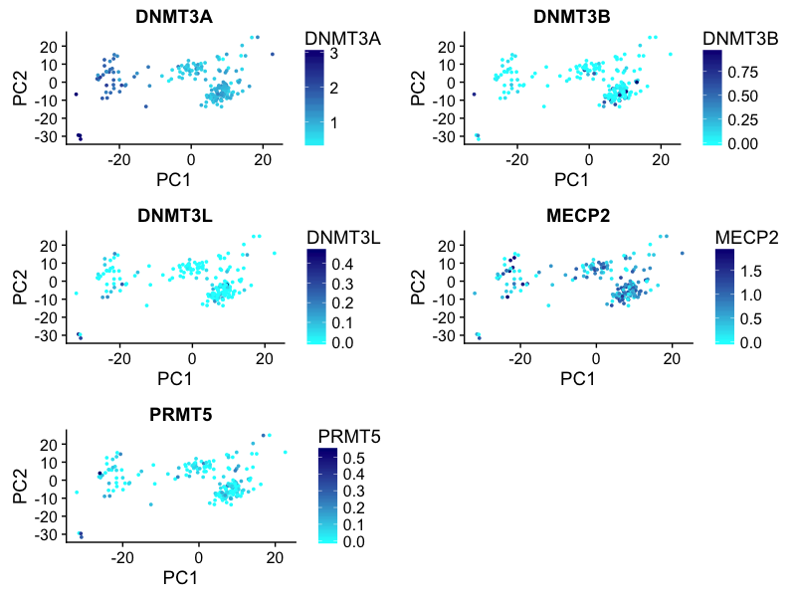
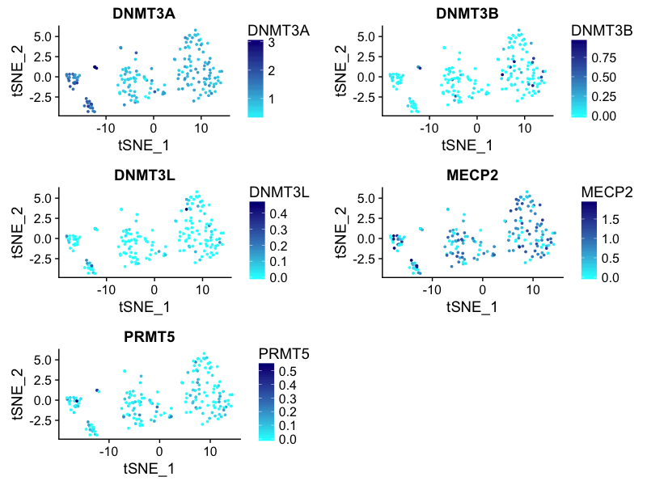
DNA Methylation Genes
PCA space
tSNE space

Slide 24
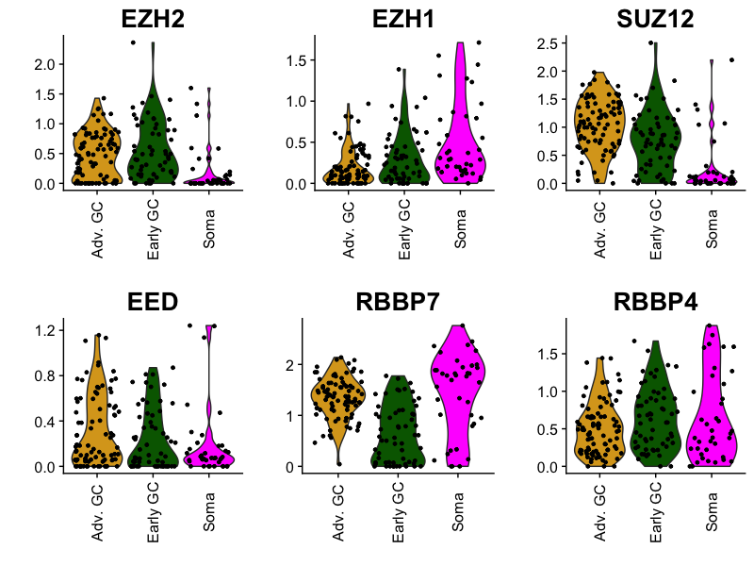
H3K27 Methylation Genes

Slide 25
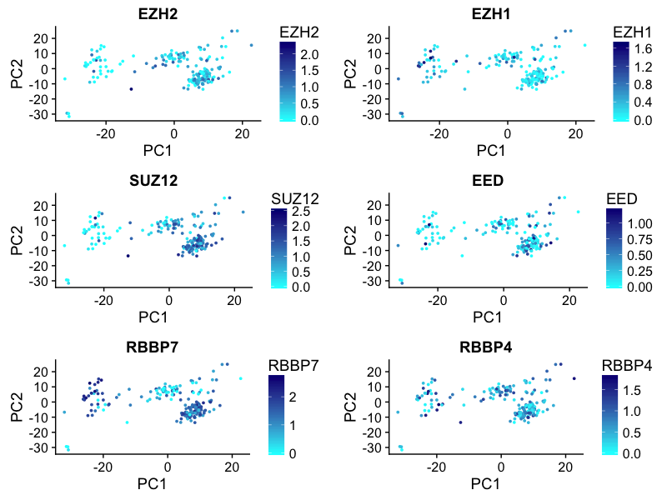
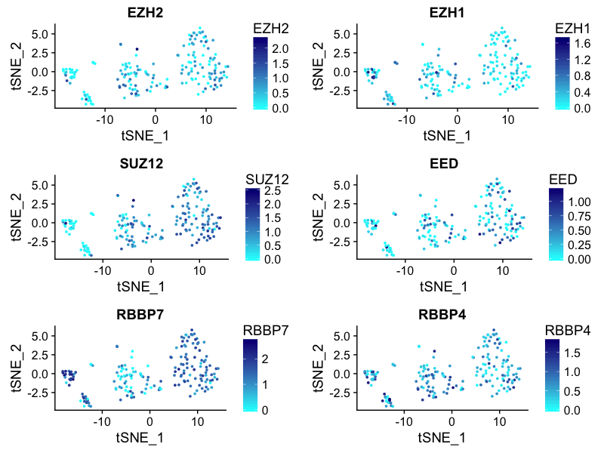
H3K27 Methylation Genes
PCA space
tSNE space

Slide 26
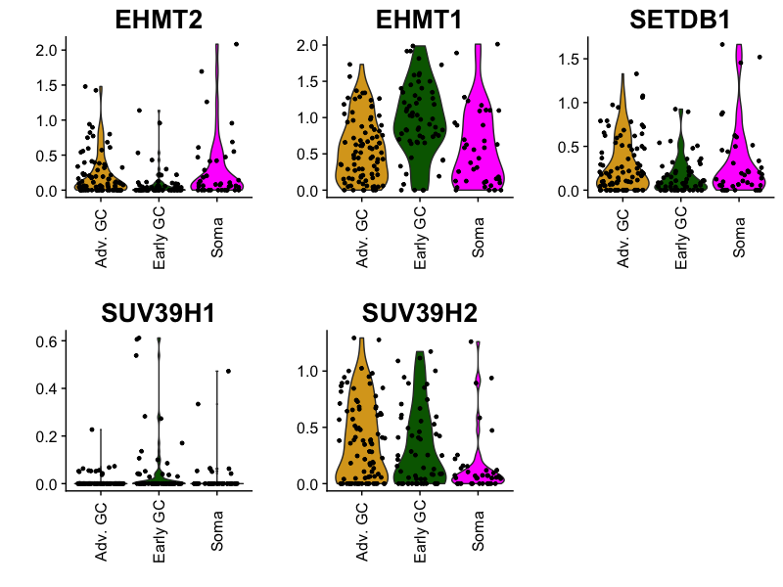
H3K9 Methylation Genes

Slide 27
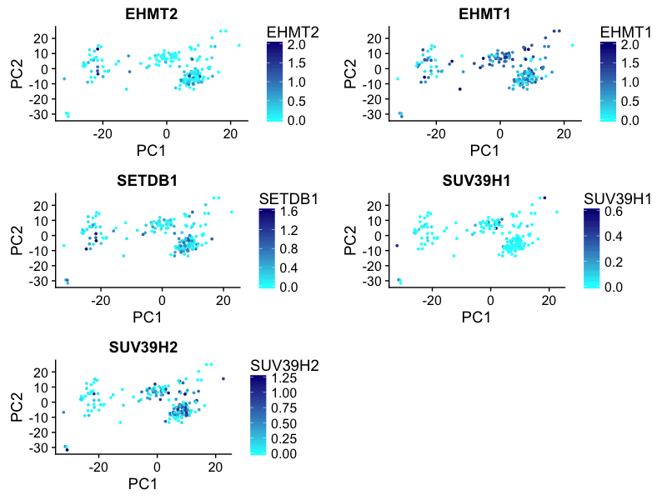
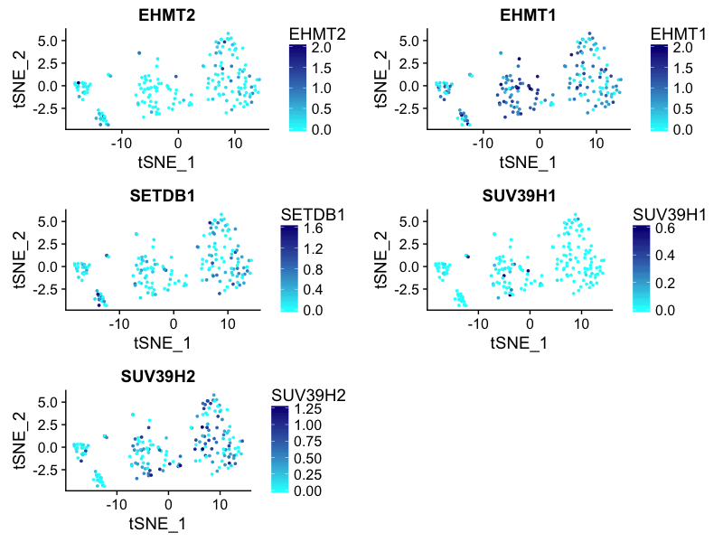
H3K9 Methylation Genes
PCA space
tSNE space

Slide 28
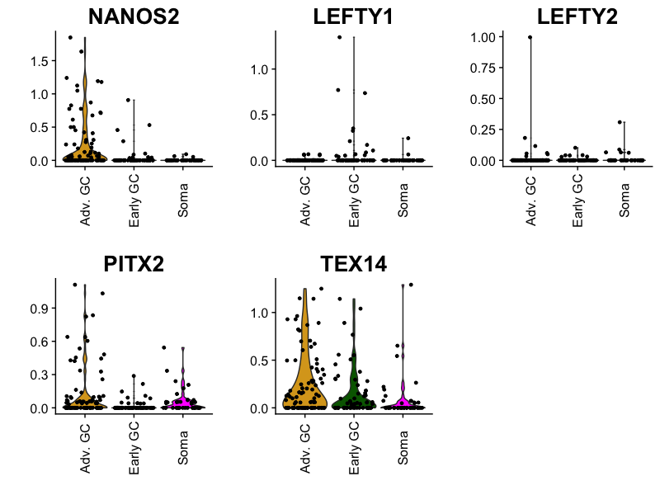
Male Differentiation Genes

Slide 29
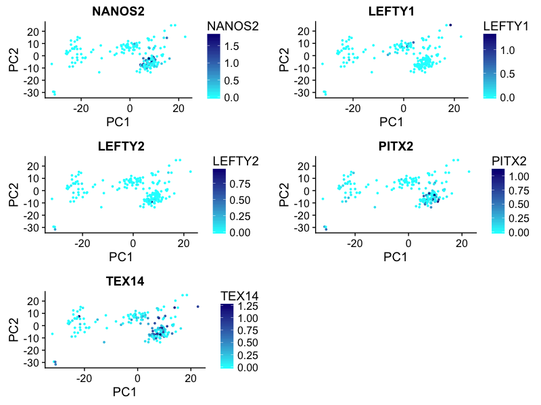
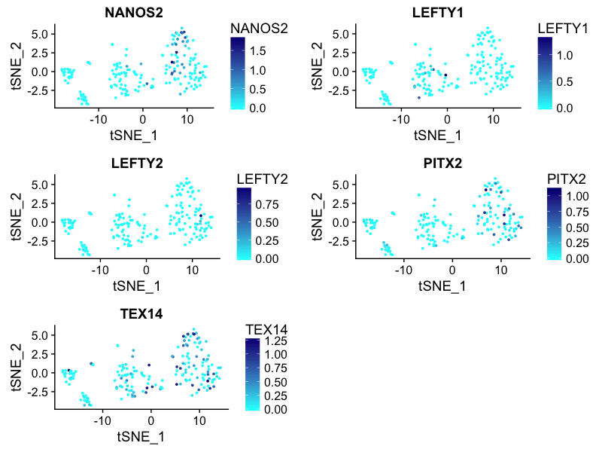
Male Differentiation Genes
PCA space
tSNE space

Slide 30
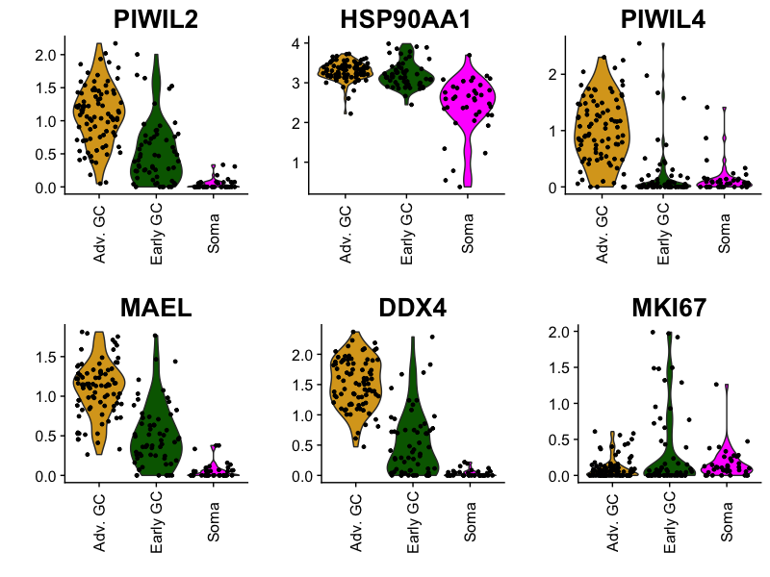
piRNA Pathway Genes

Slide 31
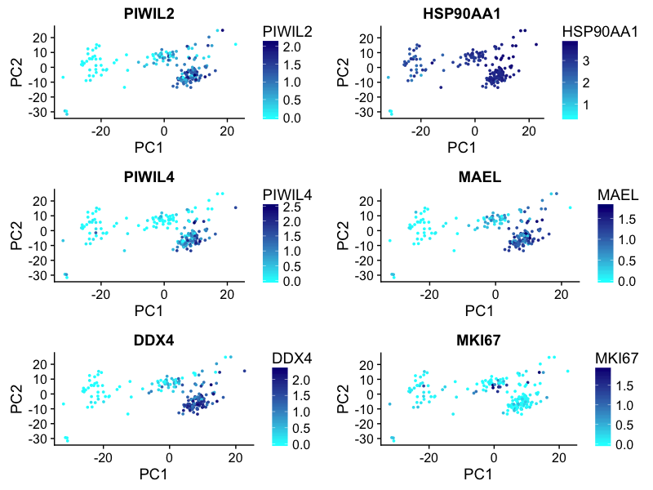
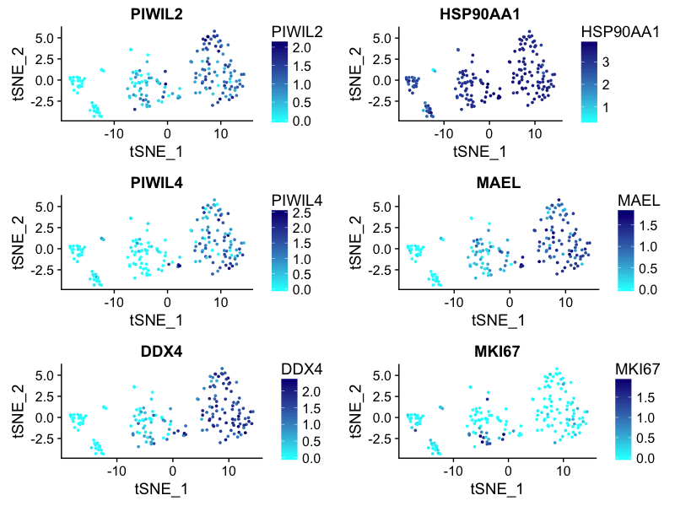
piRNA Pathway Genes
PCA space
tSNE space

Slide 32
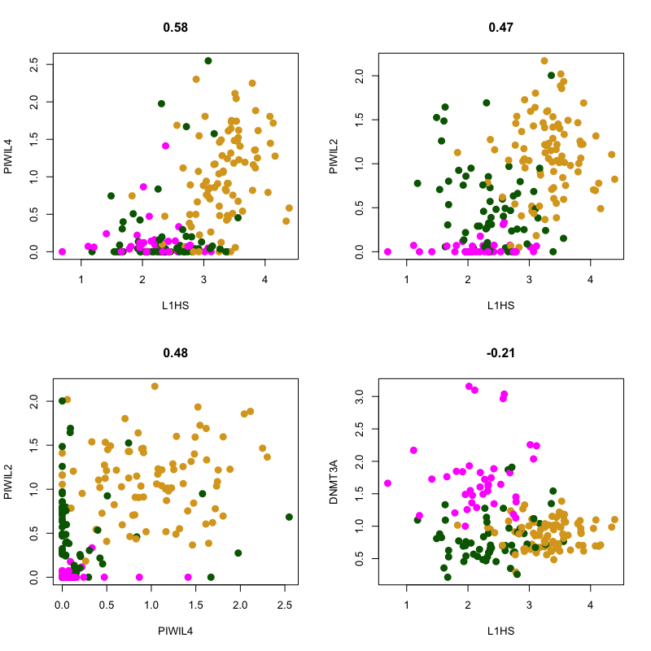
Gene comparisons L1HS

Slide 33
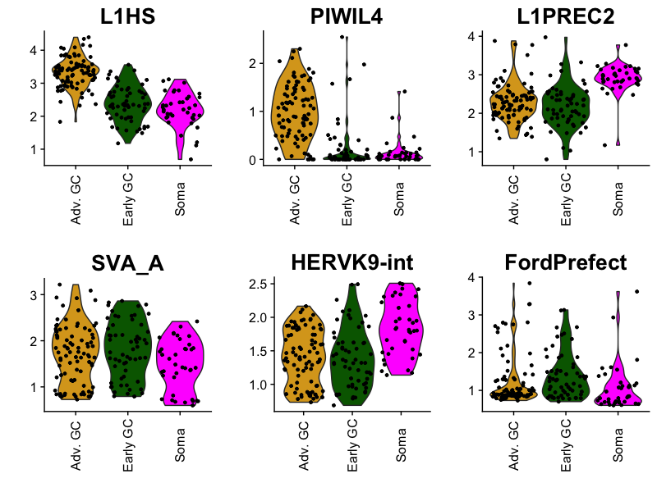
L1HS, PIWIL4, L1PREC2, SVA_A, HERVK9-int, FordPrefect

Slide 34
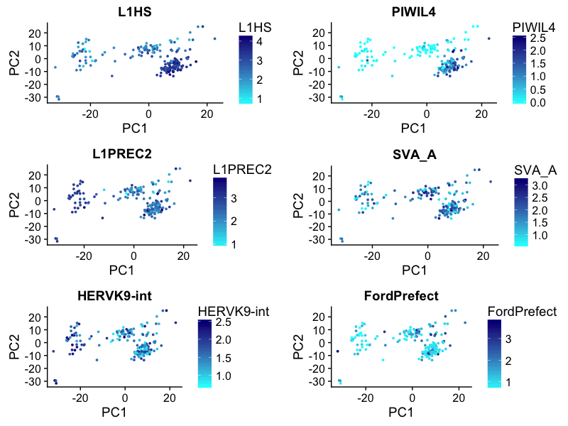
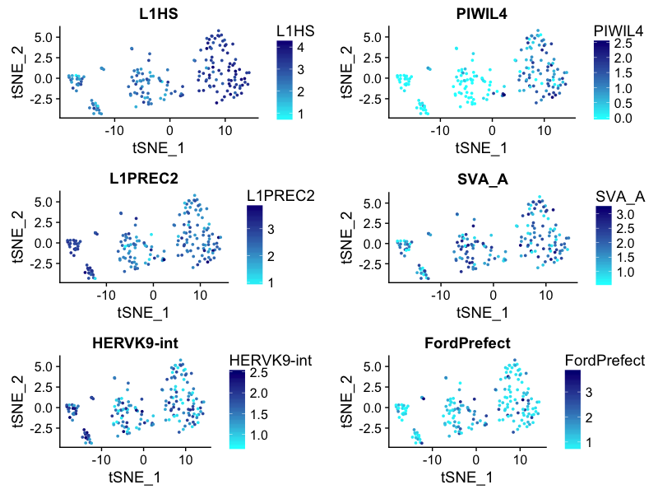
L1HS, PIWIL4, L1PREC2, SVA_A, HERVK9-int, FordPrefect
PCA space
tSNE space
VASA^{neg} OCT4^{neg} germ cells

Slide 35
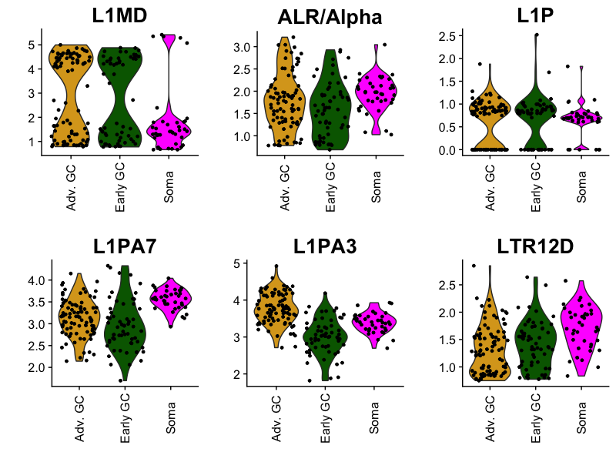
L1MD, ALR/Alpha, L1P, L1PA7, L1PA3, LTR12D

Slide 36
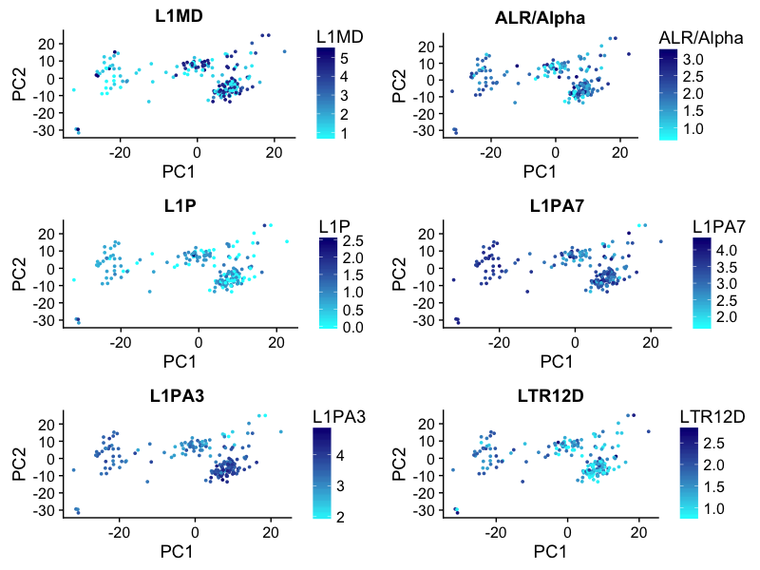
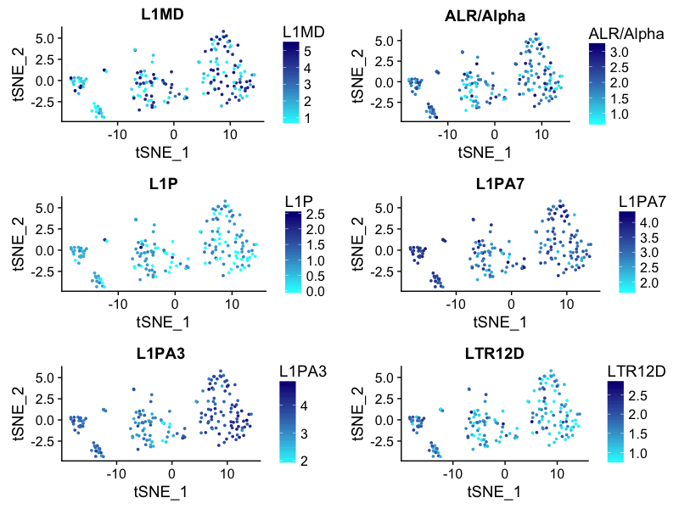
L1MD, ALR/Alpha, L1P, L1PA7, L1PA3, LTR12D
PCA space
tSNE space
VASA^{neg} OCT4^{neg} germ cells

Slide 37
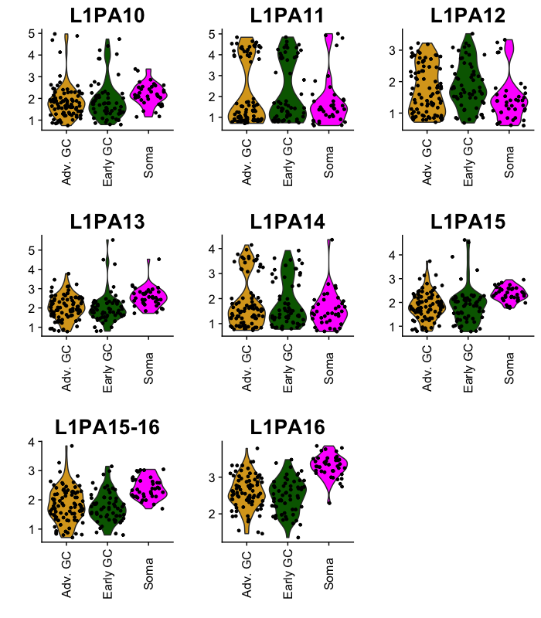
L1PA* (one of the youngest transposons) subsets batch 1

Slide 38
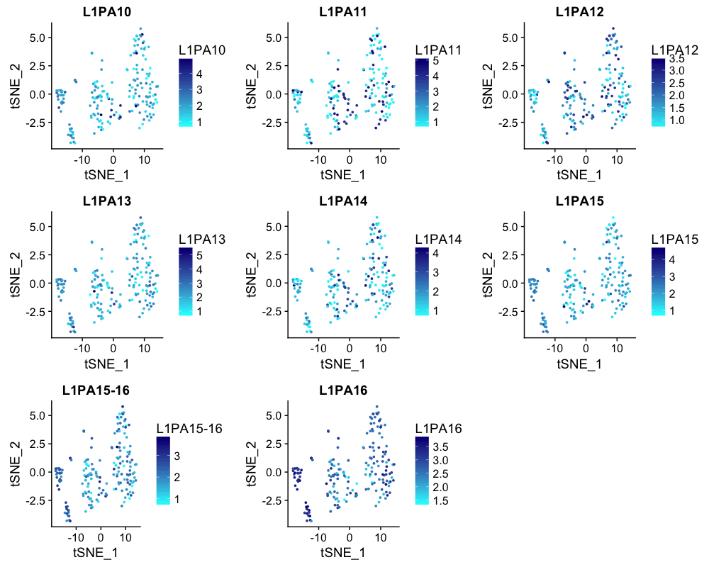
L1PA* (one of the youngest transposons) subsets batch 1
VASA^{neg} OCT4^{neg} germ cells

Slide 39
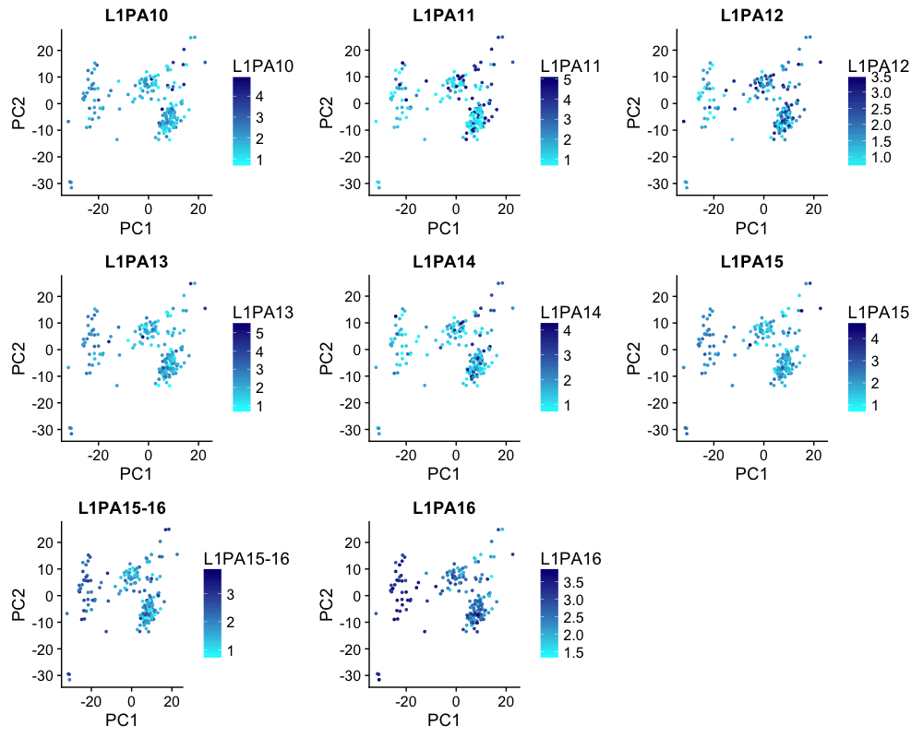
L1PA* (one of the youngest transposons) subsets batch 1

Slide 40
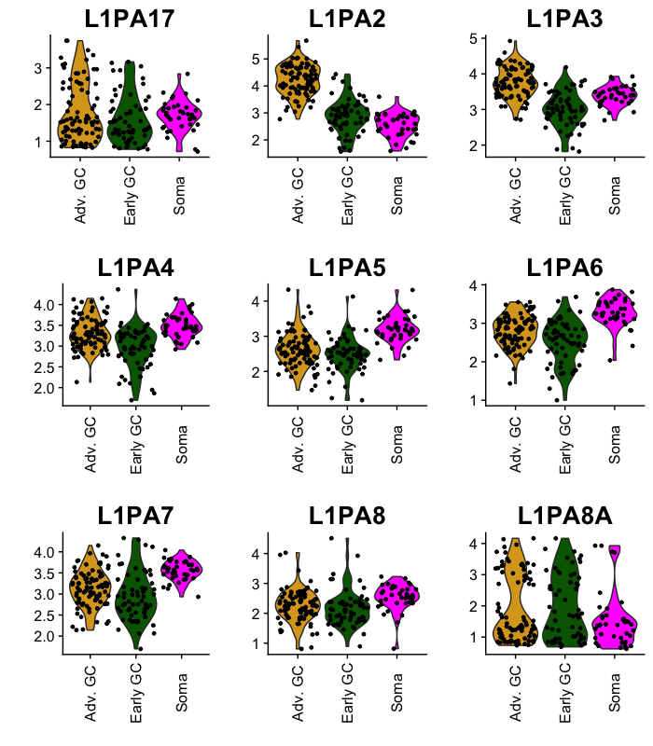
L1PA* (one of the youngest transposons) subsets batch 2

Slide 41
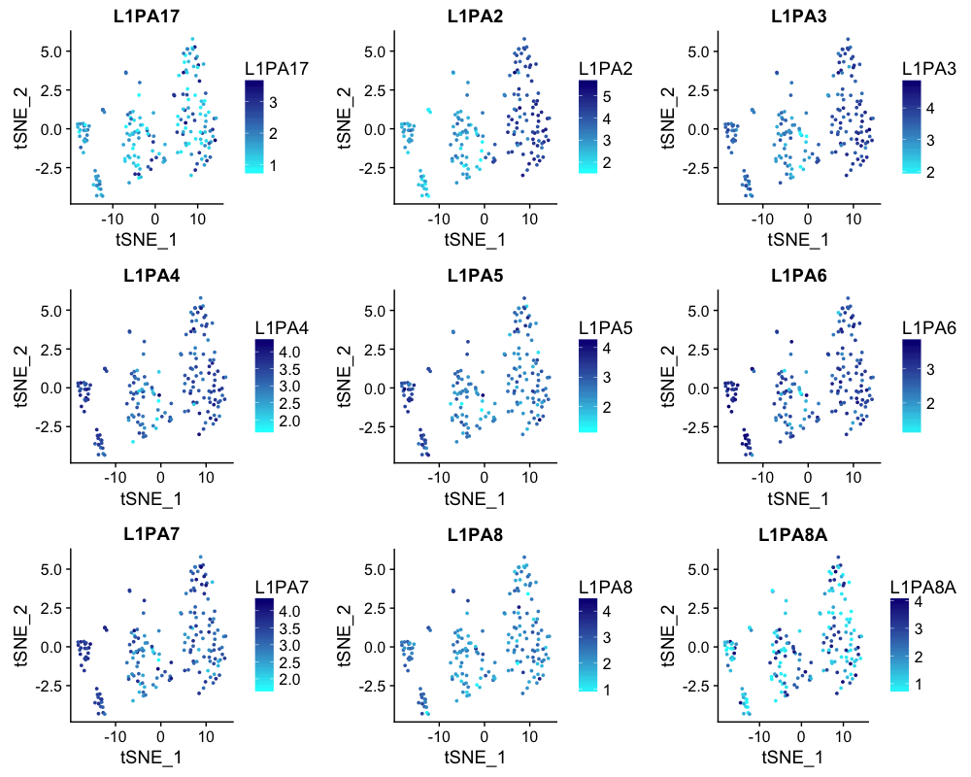
L1PA* (one of the youngest transposons) subsets batch 2

Slide 42
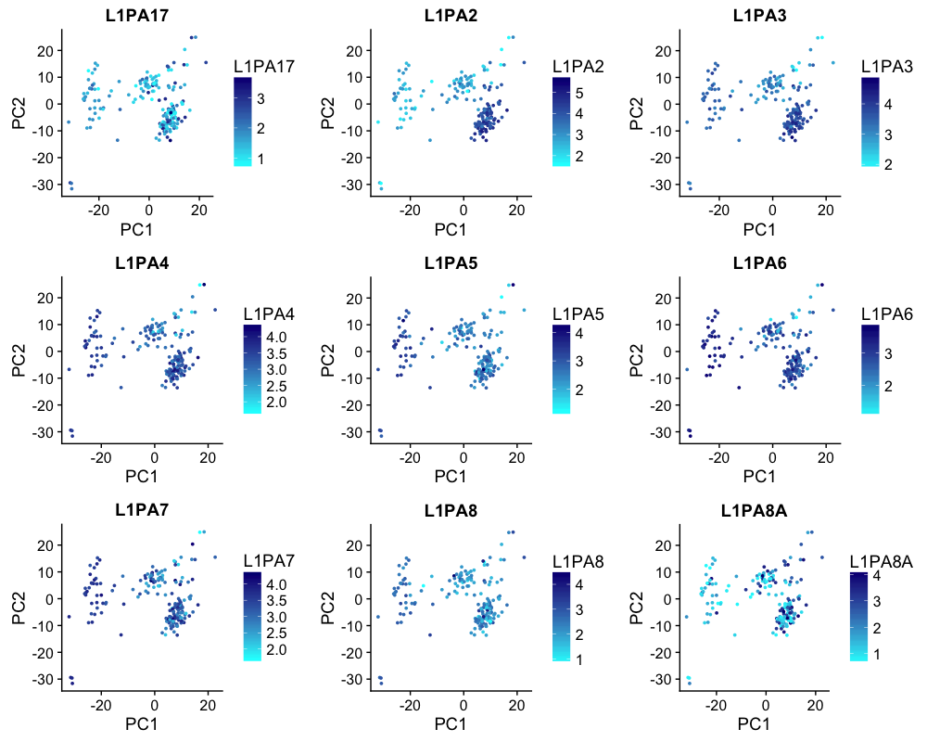
L1PA* (one of the youngest transposons) subsets batch 2

Slide 43
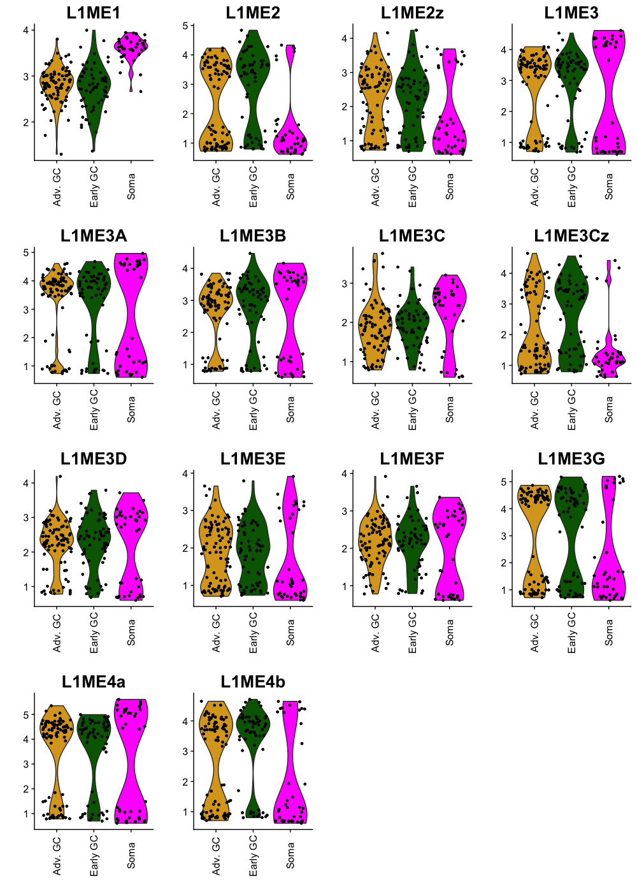
L1ME* (one of the oldest transposons) subsets batch 1

Slide 44

L1ME* (one of the oldest transposons) subsets batch 1

Slide 45

L1ME* (one of the oldest transposons) subsets batch 1

Slide 46

L1ME* (one of the oldest transposons) subsets batch 2

Slide 47

L1ME* (one of the oldest transposons) subsets batch 2

Slide 48

L1ME* (one of the oldest transposons) subsets batch 2

Slide 49

SVA family

Slide 50

SVA family

Slide 51

SVA family

Slide 52

HSP90 x L1HS

Slide 53

KI67 x L1HS

Slide 54

POU5F1 x L1HS

Slide 55

DDX4 x L1HS

Slide 56

PIWIL4 x AluY

Slide 57

PIWIL4 x AluYa5

Slide 58

PIWIL4 x AluYa8

Slide 59

PIWIL4 x AluYb8

Slide 60

PIWIL4 x AluYc

Slide 61

PIWIL4 x AluYc3

Slide 62

PIWIL4 x AluYd8

Slide 63

PIWIL4 x AluYe5

Slide 64

PIWIL4 x AluYe6

Slide 65

PIWIL4 x AluYf1

Slide 66

PIWIL4 x AluYg6

Slide 67

PIWIL4 x AluYh3

Slide 68

PIWIL4 x AluYh3a3

Slide 69

PIWIL4 x AluYh7

Slide 70

PIWIL4 x AluYh9

Slide 71

PIWIL4 x AluYi6_4d

Slide 72

PIWIL4 x AluYi6

Slide 73

PIWIL4 x AluYj4

Slide 74

PIWIL4 x AluYk2

Slide 75

PIWIL4 x AluYk3

Slide 76

PIWIL4 x AluYk4

Slide 77

PIWIL4 x AluYk11

Slide 78

PIWIL4 x AluYk12

Slide 79

PIWIL4 x AluYm1

Slide 80

PIWIL4 x L1HS

Slide 81

PIWIL4 x L1PA3

Slide 82

PIWIL4 x L1PA7

Slide 83

PIWIL4 x L1PA11

Slide 84

PIWIL4 x L1PA14

Slide 85

PIWIL4 x SVA_A

Slide 86

heatmap depicting the repeat element markers of the two GC clusters

Slide 87

heatmap depicting the top 20 repeat element markers of the two GC clusters

Slide 88

heatmap depicting the top 20 repeat element (after excluding all the tRNA because they were potentially boring) markers of the two GC clusters

